Slide 1
Intro to FP
With Clojure and Python
Nir Rubinstein – System Architect @ AppsFlyer

Slide 2
OOP vs FP
“OOP makes code understandable by encapsulating moving parts.”
“FP makes code understandable by minimizing moving parts.”
- Michael Feathers

Slide 3
What is FP?
Anyone?!
Notes:
Talk about the modeling choice

Slide 4
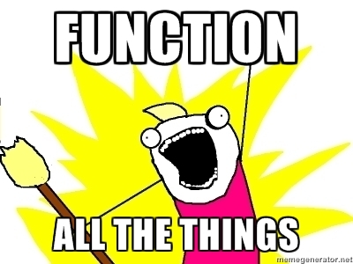
Higher Order Functions
Notes:
Show the sample python code

Slide 5
Short intro to Clojure
Syntax:
Numbers: 1234, 1.234, 1.234M
Ratios: 22/7
Strings: “foo”, “bar”, Characters: \a \b \c
Symbols: foo, bar, Keywords: :foo, :bar
Boolean: true, false, Null: nil
Regex Patterns: #”a*b”

Slide 6
Short intro to Clojure – Cont'd
Data Structures:
Lists – singly linked, grow at front:
  (1 2 3 4)
Vectors – indexed, grow at end:
  [1 2 3 4]
Maps – key/value associations:
  {:a 1 :b 2 :c 3}
Sets: #{:a :b :c}
Everything nests inside each other

Slide 7
Short intro to Clojure – Cont'd
Almost everything else is function invocation
Back to higher order functions: how does it look like in Python and in Clojure...

Slide 8
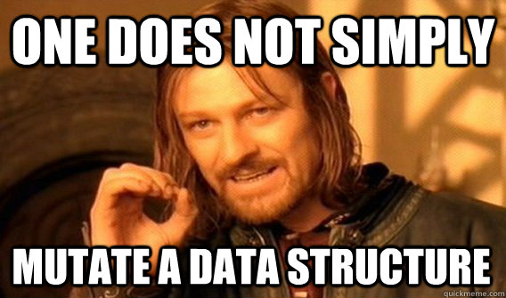
Immutability
Notes:
Show python for mutability
Show Clojure for Immutability

Slide 9
Statements Vs. Expressions
What's with that “return” at the end of a function?
Expressions have a value
Statements do not have a value (side effects)
Notes:
Show python for statements
Shoe Clojure for expressions

Slide 10
Lambda Calculus
“A formal system in mathematical logic for expressing computation based on function abstraction and application using variable binding and substitution”
- Wiki
What does it compare to?
Programming with expressions!

Slide 11
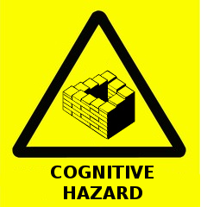
Referential Transparency
What happens when state “pollutes” our functions?
Notes:
Show in both Python and Clojure

Slide 12

Purity
Is Clojure a pure FP language?
Why Not?
Notes:
Talk about atoms, refs etc.

Slide 13

Recursion

Slide 14
Recursion Explained
FP paradigm usually forgoes imperative iteration in favor of:
  Map
  List Comprehension
  Recursion
The most common denominator for all of the above is that they promote values over side effects

Slide 15
Recursion – cont'd
Almost all of the higher level functions and macros of a functional language that have to do with producing some value out of a sequence of data, can be described/written with recursion.
Why is Recursion so hard to “grok”?

